Slide 1

Blockchain Technology
-Gayathree Iyer
&
Aishvwarya Iyer

Slide 2
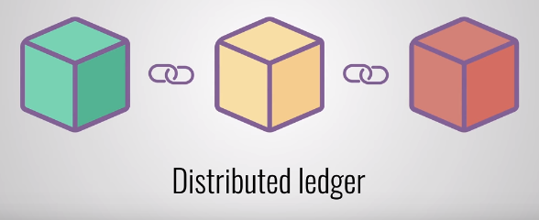
What is Blockchain??
Technology for keeping records of transactions using cryptography and distributed (peer-to-peer) systems.
Decentralized public database/ledger that can record transactions in a verifiable and permanent way in a trustless environment.

Slide 3
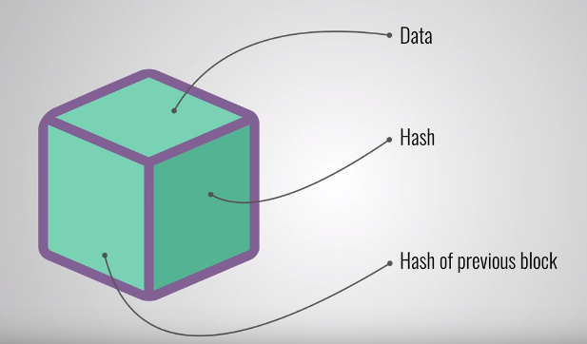
What is Block??
Container data structure.
Storage space for any data which is to be stored in a linear form.
In the Bitcoin world, a block contains more than 500 transactions on average.
Average size of a block -1MB

Slide 4
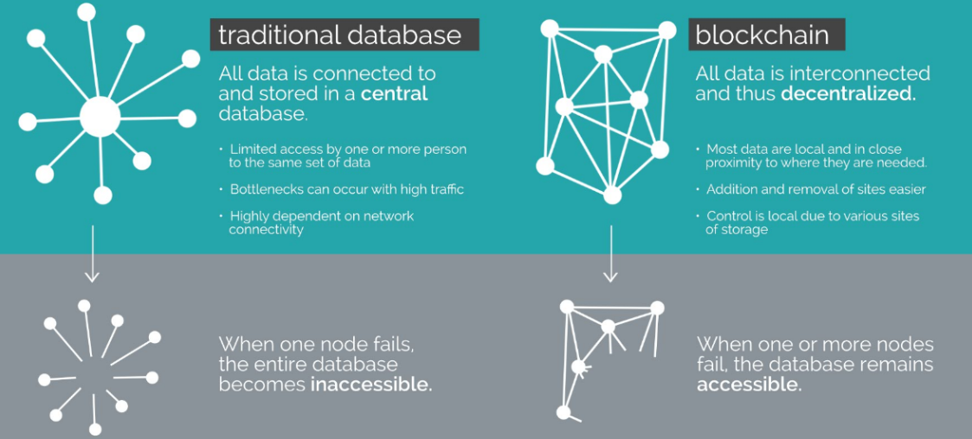
Traditional Database vs Blockchain

Slide 5
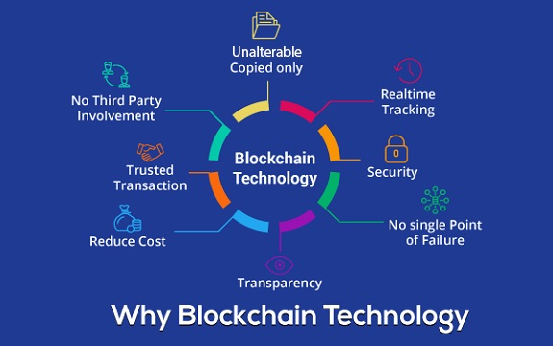



Why Blockchain??

Slide 6
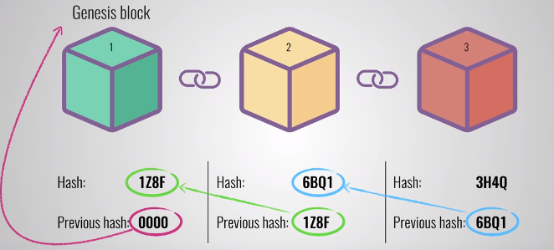
Time for an Example !!

Slide 7
Security in Blockchain
Each block is connected to all the blocks before and after it.
This makes it difficult to tamper with a single record.
The records on a blockchain are secured through cryptography.
Network participants have their own private keys that are assigned to the transactions they make and act as a personal digital signature.
If a record is altered, the signature will become invalid and the peer network will know right away that something has happened.
Early notification is crucial to preventing further damage.

Slide 8
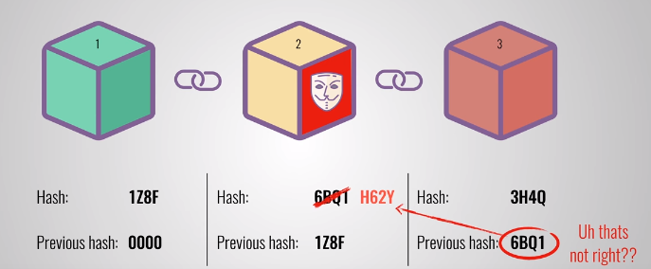
When a block is tampered……..

Slide 9
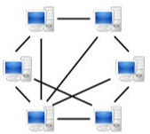

Decentralized Storage
Blockchain is designed in a way that the storage location or central authority doesn’t exist.
On the network, every user has a role to play in storing some or all the blockchain.
Everyone in the blockchain network is responsible for verifying the data that is shared and/or maintained to ensure existing data can’t be removed and false data can’t be added.

Slide 10
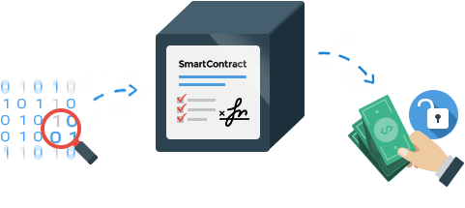
Smart Contract
Also known as Crypto-contract
Computer program that directly controls the transfer of digital currencies or assets between parties under certain conditions.
Defines the rules and penalties around an agreement in the same way that a traditional contract does, but it can also automatically enforce those obligations.
It does this by taking in information as input, assigning value to that input through the rules set out in the contract, and executing the actions required by those contractual clauses.
Blockchain is ideal for storing smart contracts because of the technology's security and immutability.

Slide 11

How Blockchain prevents Double Spending ?
For every transaction, owner signs the transfer with his private cryptographic key.
Transferrer requires asset & private key.
Blockchain checks validity of key and ownership of the asset.
Double Spending will be detected.

Slide 12
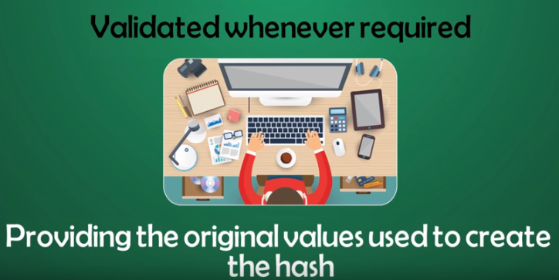
How Blockchain ensures privacy ?
Personal data and Identifiers stored as hash value.
Provides anonymity and security.
Data is hashed to create a unique token.

Slide 13
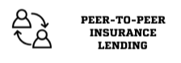




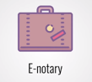
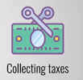



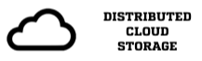


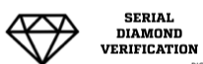
Applications

Slide 14
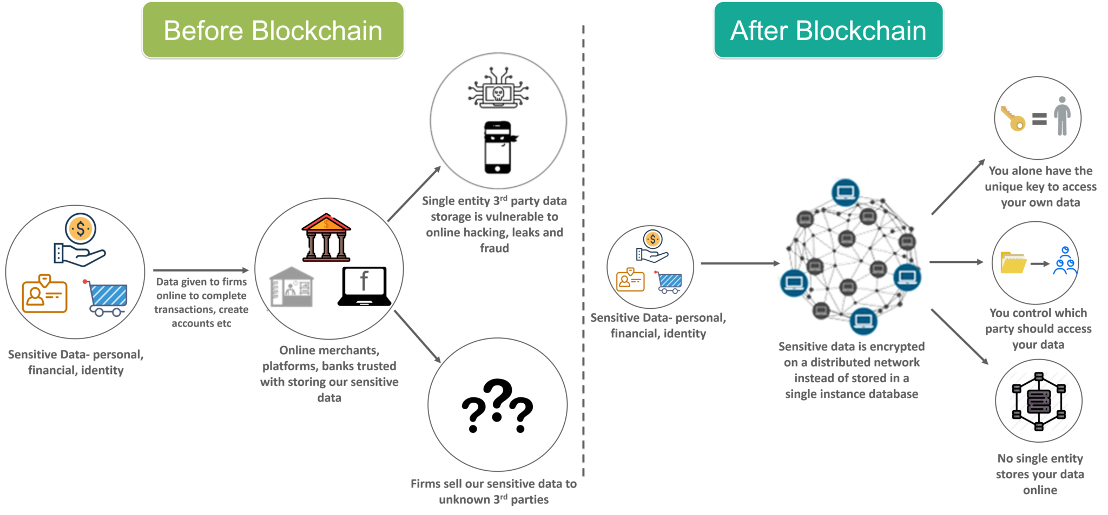

Slide 15
References
https://www.infosecurity-magazine.com/next-gen-infosec/blockchain-cybersecurity/
https://www.techquark.com/2017/06/blockchain-developers-guide-use-cases.html
https://searchcompliance.techtarget.com/definition/smart-contract
https://www.ibm.com/blogs/blockchain/2017/12/blockchain-security-what-keeps-your-transaction-data-safe/

Slide 16


